Slide 1
Employee Attrition & Performance Prediction(HR Analytics)
Objective:
Identify key drivers of employee attrition, such as age, income, and job role.
Predict employees likely to leave using advanced machine learning techniques.
Provide actionable insights to HR for improving employee retention and organizational efficiency.
Dataset:
Size: 1470 records (rows)
Features: 35 features(columns) including demographics (e.g., Age, Gender), job details (e.g., Department, Job Role, Monthly Income), and historical data (e.g., Number of Companies Worked, Years at Current Role).
Key Tools:
Data Manipulation and Visualization: Pandas, Seaborn, Matplotlib, Plotly.
Machine Learning Models: XGBoost, CatBoost, Random Forest, Gradient Boosting, Logistic Regression.
Class Imbalance Handling: SMOTE (Synthetic Minority Oversampling Technique).
Evaluation Metrics: Accuracy, Precision, Recall, and F1 Score to measure model performance.
Yuvraj Singh Srinet 25PGAI0019

Slide 2
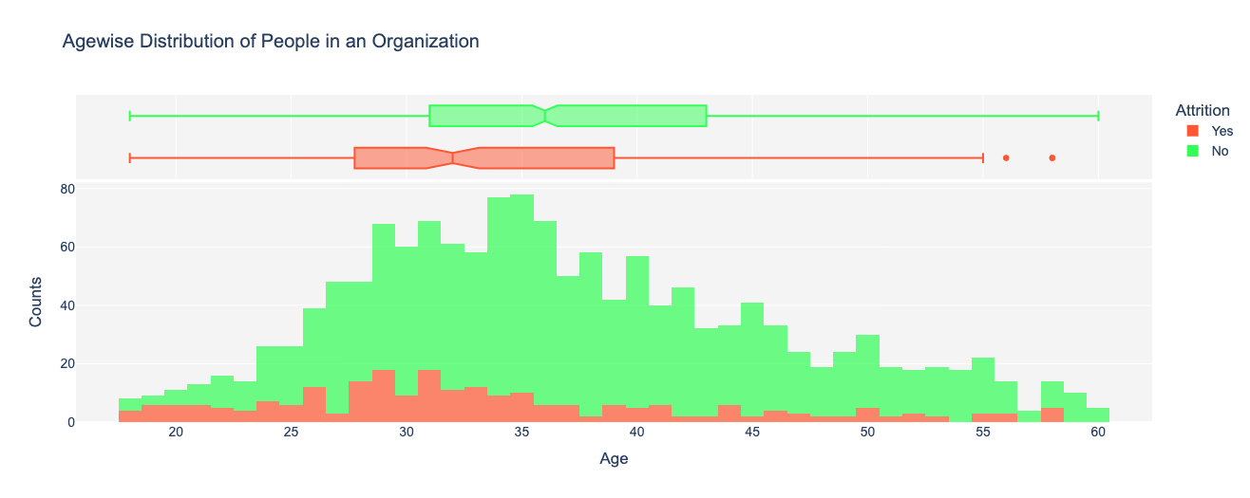
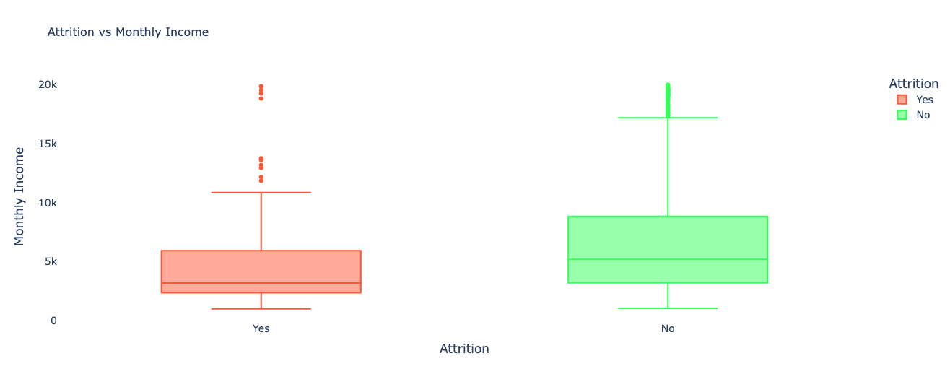
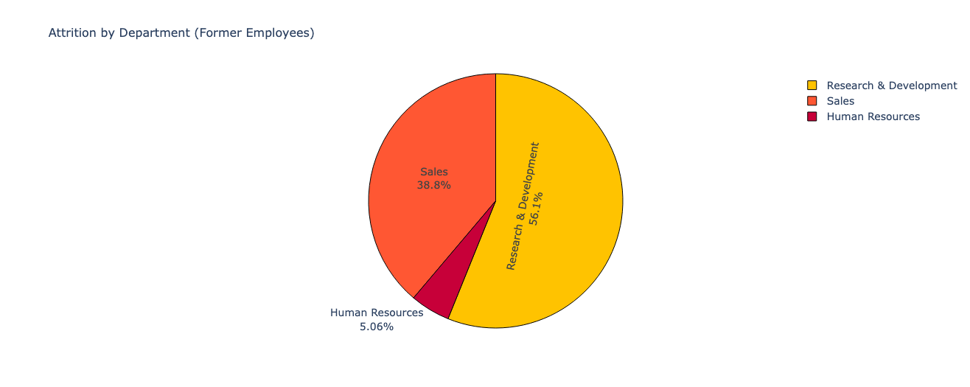
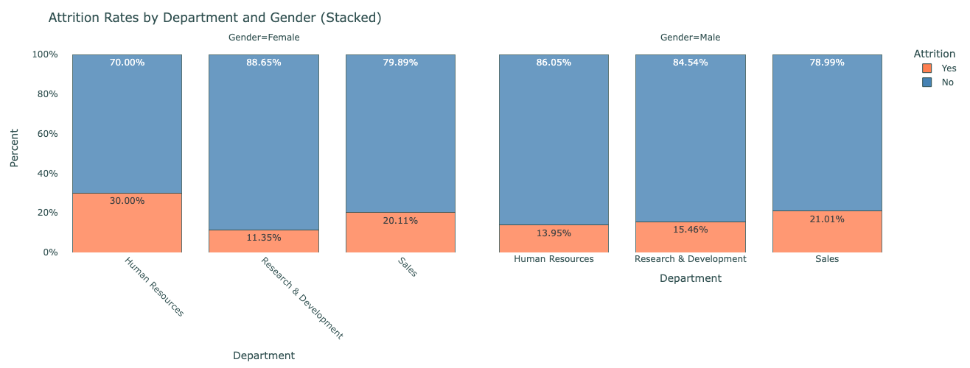
Data Visualizations

Slide 3
Insights from Data Analysis
Age Factor:
Attrition highest among employees aged 28-32.
Young employees (18-20) also show higher attrition due to career exploration.
Departmental Trends:
Research & Development: 56.1% attrition, indicating potential dissatisfaction in high-pressure roles.
Sales: 38.8% attrition, likely due to target-driven stress or inconsistent incentives.
Human Resources: Lowest attrition (5.06%), showing better retention strategies.
Income Impact:
Lower income correlates strongly with higher attrition.
Employees with higher income variability tend to stay longer.
Visual Examples:
Bar Chart: Attrition Distribution shows class imbalance (~16% attrition).
Boxplot: Monthly Income vs. Attrition highlights income disparities.
Stacked Bar Chart: Attrition by Department and Gender demonstrates department-specific trends.

Slide 4
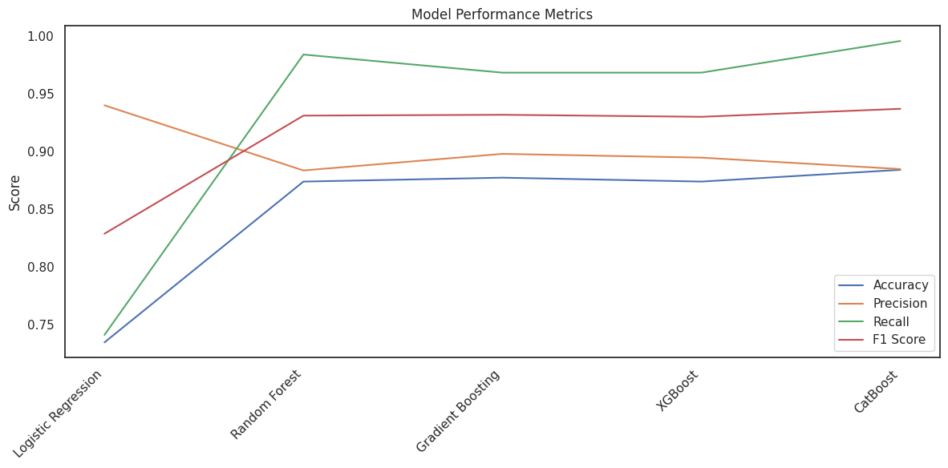
Model Performance
Top Models and Metrics:
Cat Boost:
Accuracy: 88.4%.
Recall: 99.6% (outstanding at identifying employees likely to leave).
F1-Score: 93.7%.
Key Strength: Handles categorical variables effectively without preprocessing.
Random Forest & Gradient Boosting:
Recall: ~97%.
Strong F1-scores (~93%).
Effective in handling non-linear relationships.
Logistic Regression:
Accuracy: 73.4%.
Weak Recall (74%), making it less effective for minority class detection.
Challenges:
Significant class imbalance addressed using SMOTE to enhance minority class representation.
Ensuring generalizability of models across diverse employee demographics.

